Slide 1

Websites one - HMV
by Arran Hopkins

Slide 2

Use and Purpose
The use of the website is to buy films, music and games and have them sent to your home without you leaving and you can trust HMV on the information about their items because the are solely built for these items.
Also the purpose is to make shopping for films, music and games easier for people how do not have a HMV shop close to you or people how have illness or disables to get what they want and for HMV to make more money because they are not just limited to the shops.

Slide 3
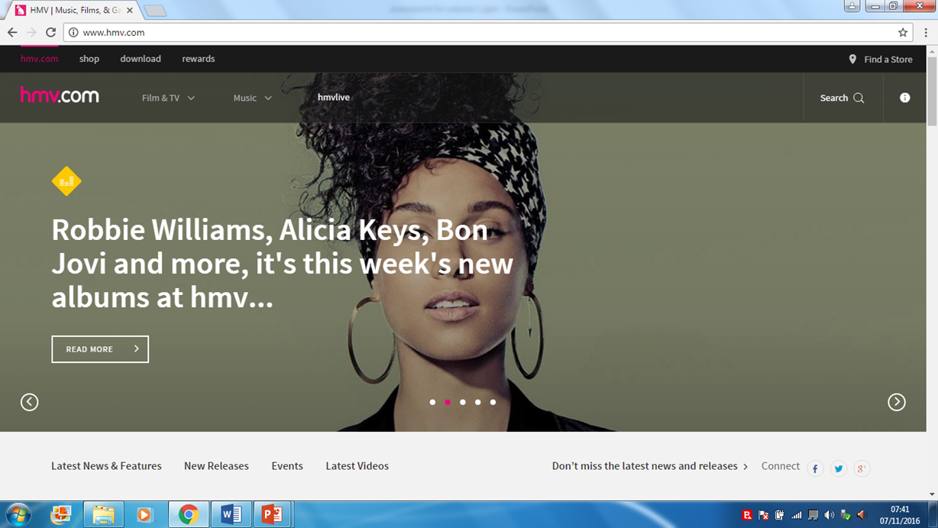
HMVs website homepage
This is where you can find the physical store
He is the search bar
The links at the top and pick a genre to different pages
Ads for there items

Slide 4
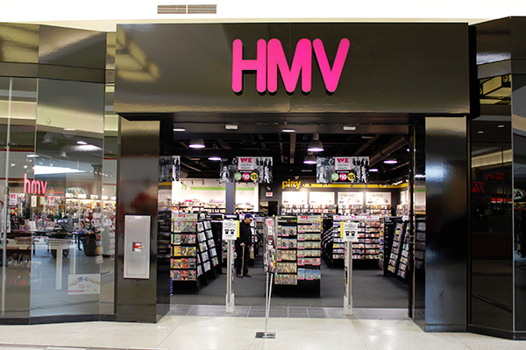
Target Audience
The target audience is everyone and all genders but older people may not know how to use the website and not all people have an interest in the items that they sell. Also not everyone has a computer so some people will not be able to use it so they have to go to a HMV store or buy from a different store.

Slide 5

Features of the website
The Features of the website are a search bar where you can search for films, music and games on the site and you can look for something more specific like a name of a film and it will take you to it.
Also you can download music from the website and you can get loyalty rewards which you can get if you buy items from HMV regularly then you can get specials deals, being entered into for specials rewards like cinema tickets and tickets for music events.
Also the website has ads for there deals and exclusive items which if you click on them it will take you to the page and at the bottom of the page they have list of deals, upcoming releases and now releases.
Also the colour of the website is black and pink and with some white on the text which is talking about a item and there is images of the items as well.

Slide 6
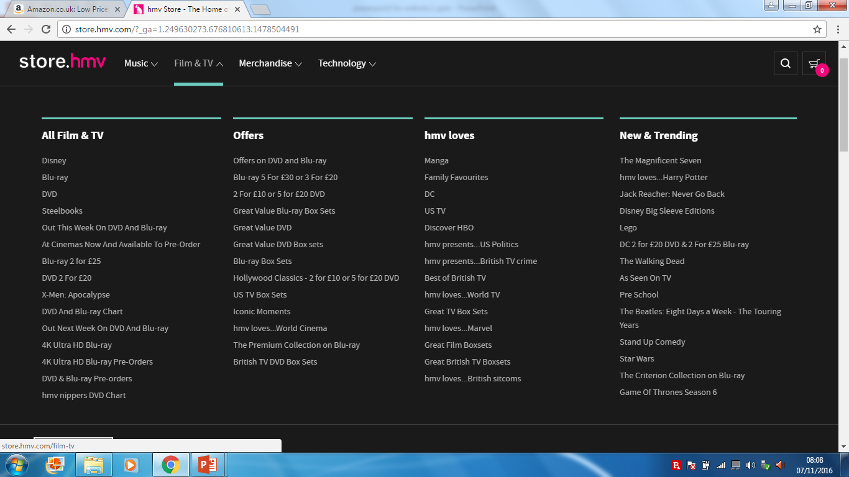
The links in film and TV
Also they have recommend items links and news on movies and TV
The film and TV has all different items you can pick
Also they have the deals like 5 blu-rays for £30

Slide 7
Review the features on HMV
The presentation of the website is lay out good but there is something they should change and put deals for items on the home page and not have to look for them.
The usability of the website is very good for all age which can use it and they lay out the links and the items on page very easy to see which I find it hard to see links on other websites.
The accessibility of the website is good but it does not have any thing for blind people but the website is good for other disabilities. Also for old people the website might be confusing because of the amount of information on the page at once.
The performance of HMVs website is very good because it runs nicely without any slowdown or crashing.

Slide 8
Strengths and weaknesses of HMV
Strengths of HMV | Weaknesses of HMV
One strength of the HMV website is you can download music off the website without having to buy a CDs. | One weakness of the HMV website is it does not lay out films and music and games new release very well.
Second strength of HMV website is the loyalty rewards which is when you save up your points from buy lots of items you can spend them on rewards. | Second weakness of the HMV website is that the help icon is at the bottom of the page not at the top.
Third strength of HMV is that you can buy multiple format of items such as Blu-rays which could be 4k Blu-ray if you upgrade, steel book Blu-ray and a longer version of a film. | Third weakness is that HMVs website is not the must viewed website so if you search for a items it sells HMV will not be the first website to show.
Fourth strength is that you can look at the latest articles of movies or music on the site. | Fourth weakness is that you can not list the items you want so you would have to search for all the items for a second time.

